Slide 1
The Science of Psychology
Chapter 1

Slide 2

The Science of Psychology
What is Psychology?
The Science of Psychology: Goals, Hypotheses, and Methods
Ethical Principles of Psychological Research
Psychology in the Modern World: Foundations and Growth
Psychology Applies to Your World: Training to Be a Psychologist
Integrating Psychology: The Big Picture

Slide 3

The Field of Psychology
Notes:
The study of psychology emphasizes scientific inquiry of behavior and mental processes.
“What do we do, and why do we do it?”
It relies on the scientific method, which is a formalized system of procedures for building and testing hypotheses about behavior.

Slide 4
Correcting Common Misconceptions About the Field of Psychology (1 of 2)
TABLE 1.1 How Much Do You Know About Behavior?
Indicate whether you believe each statement is true (T) or false (F).
1 | We are either left-brain or right-brain thinkers. (Ch.2) | T | F
2 | We have only five senses. (Ch. 3) | T | F
3 | During sleep, the brain rests. (Ch. 4) | T | F
4 | Dieting is an effective way to lose weight. (Ch. 5) | T | F
5 | Punishment is more effective than reinforcement in producing behavior change. (Ch. 6) | T | F
Notes:
Do you believe that we only use 10% of our brains? Are you convinced that a person is either “left-brained” or “right-brained”? Maybe you think that having schizophrenia means to have a split personality. These are examples of commonly held misconceptions from the field of psychology.
Psychology is rooted in scientific research, which involves the formation of theories that help us generate and test hypotheses.
How do you think psychology differs from “everyday” or “commonsense” knowledge?

Slide 5
Correcting Common Misconceptions About the Field of Psychology (2 of 2)
6 | Our memory works like a video recorder. (Ch. 7) | T | F
7 | Intelligence is primarily encoded in our genes. (Ch. 8) | T | F
8 | Most adults experience a midlife crisis in their 40s or 50s. (Ch. 9) | T | F
9 | Opposites attract. That is we are most attracted to people who differ from us. (Ch. 10) | T | F
10 | Personality is set by our teenage years. (Ch. 11) | T | F
11 | Stress is caused by bad things that happen to you. (Ch. 12) | T | F
12 | Schizophrenia means you have multiple personalities. (Ch. 13) | T | F
13 | In order for therapy to be effective, you must confront issues from your childhood. (Ch. 14) | T | F
Notes:
Do you believe that we only use 10% of our brains? Are you convinced that a person is either “left-brained” or “right-brained”? Maybe you think that having schizophrenia means to have a split personality. These are examples of commonly held misconceptions from the field of psychology.
Psychology is rooted in scientific research, which involves the formation of theories that help us generate and test hypotheses.
How do you think psychology differs from “everyday” or “commonsense” knowledge?

Slide 6

Psychology Will Teach You About Critical Thinking
Notes:
When a commercial tries to sell you a product by advertising amazing outcomes or unrealistic promises, it may be employing pseudopsychology. These may look real and impressive, but they are based on claims that are not supported by a true science. (Think “Six Minute Abs” and you’ll know what this refers to!)
A true science employs critical thinking, which is a thought process that involves analyzing and evaluating information and then applying it to other situations.

Slide 7
What Are Psychology’s Goals?
Describe
Predict
Explain
Control
Notes:
What are the goals of psychology and what questions do they answer?
Description—“What happened?”
Explanation—“Why did it happen?”
Prediction—“Will it happen again? If so, how?”
Control—“Can we influence if and how it will happen again?”
Note that this last goal, control, is easy to misunderstand. Psychologists are not interested in “controlling people,” per se. Rather, they are interested in controlling situations so that they can improve others’ lives. As an example, can we control the symptoms of schizophrenia so that a person with the condition can be happier and more productive in his or her life?

Slide 8
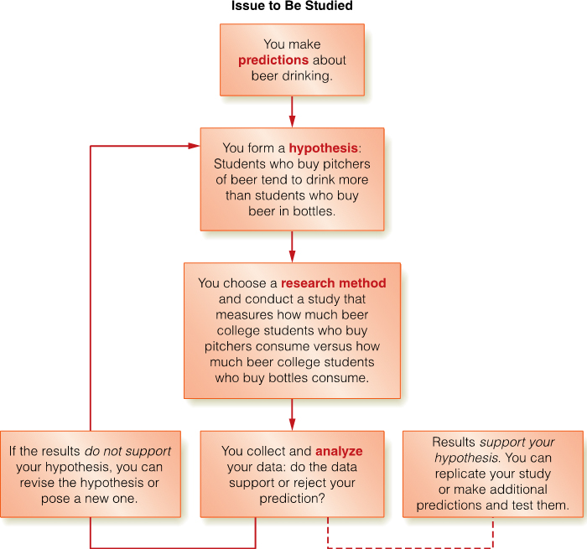
Psychologists Are Scientists: The Scientific Method
The Scientific Method
Notes:
Note that the scientific method can be thought of as a system of rules for asking and answering questions. If the rules are violated, the findings we arrive at have no true value.
Refer to your text for a thorough review of the step-by-step process of the scientific method.
1. Define and describe the issue to be studied.
2. Form a testable hypothesis.
3. Choose an appropriate research strategy
4. Conduct the study to test your hypothesis.
5. Analyze the data to support or reject your hypothesis.

Slide 9

Psychologists Ask Questions: Hypotheses
Notes:
There are two kinds of hypotheses with which psychologists work:
1. Predictive hypotheses—make assumptions about relationships between variables
2. Causal hypotheses—an educated guess as to how one variable will influence (or cause a change in) another variable
Can you come up with some examples of each?

Slide 10
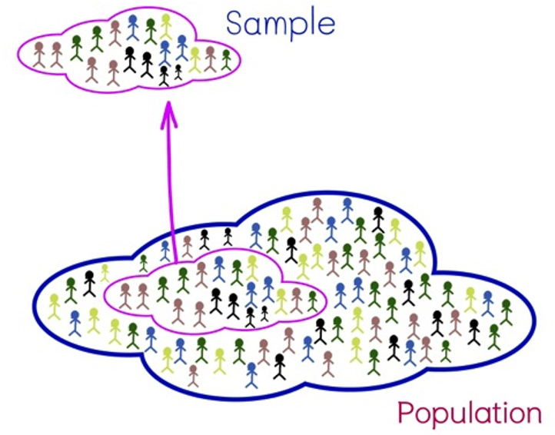
Psychologists Strategize: Sampling and Research Methods
Notes:
Research in psychology is conducted with people (or animals) who comprise a sample. This sample is meant to reflect the larger population from which it is drawn. In other words, the sample is representative of the larger population.
Read in your text about the difference between a random sample and a sample of convenience.

Slide 11

Naturalistic Observations
Notes:
When behaviors are studied and monitored in their normal or usual setting, this is called naturalistic observation. It provides the most accurate accounting possible of how people truly act, but you have to be careful not to let on that the observation is taking place. This is called reactivity.
How do you behave when you know people are watching you?

Slide 12

Case Studies and Surveys
Notes:
When a researcher gathers a lot of information about one or very few cases or people (typically in unusual circumstances), this is called a case study. The drawback is the ability to generalize the findings to others.
Probably the most widely practiced research method is the survey, which allows you to ask others about their thoughts, feelings, or positions on various topics. Surveys can gather a large amount of data with relatively little effort, but the question of validity is an ongoing one. Do people answer honestly? Are those who answer the questions representative of a larger population? Is the survey worded in clear manner that does not elicit a specific answer?

Slide 13
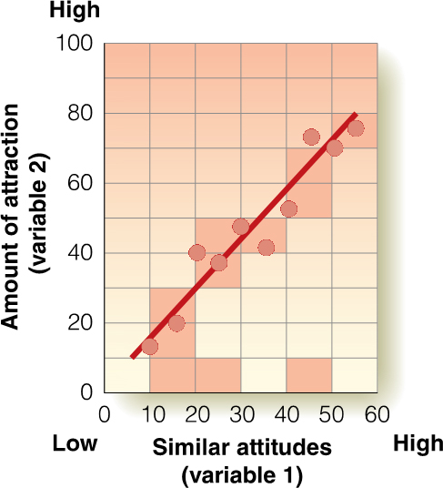
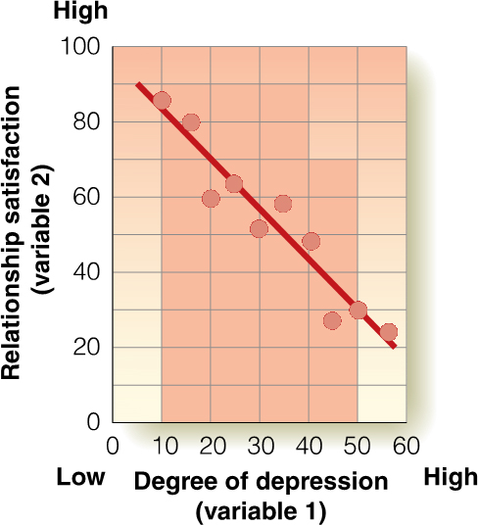
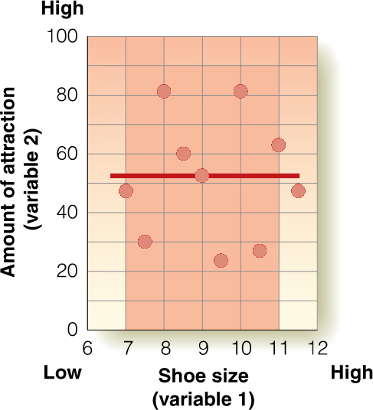
Correlational Studies
(a) Positive Correlation
(b) Negative Correlation
(c) No Correlation
Notes:
When we want to know how two variables are related to each other, or how one predicts another, we do correlational research.
This research produces a correlation coefficient, which is a numerical representation of (a) the strength between two variables (indicated by the number) and (b) the direction of that relationship (indicated by the sign).
Let’s take a look at some examples of different correlations and practice interpreting them. Remember that “correlation does not imply causation,” so you can never draw cause-and-effect conclusions from a correlational study.

Slide 14
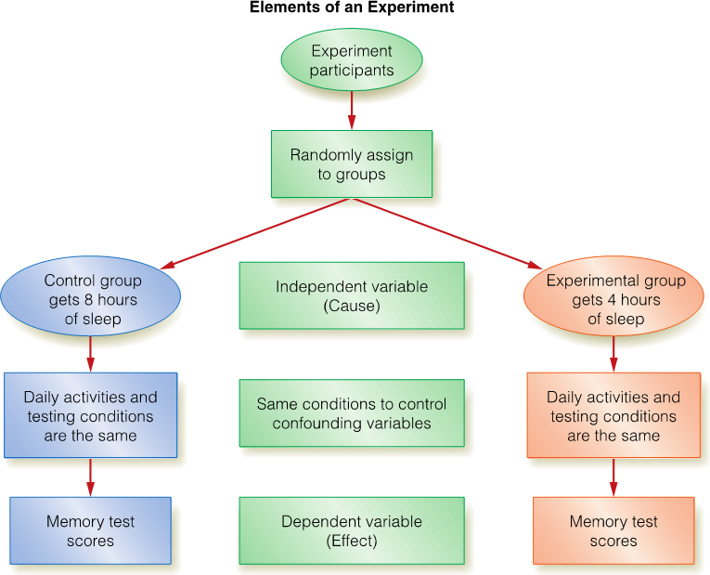
Experiments
Elements of an Experiment
Notes:
Experimental research is conducted to allow for the drawing of cause-and-effect conclusions. Experiments are not difficult, but there are several “pieces” to them! Make sure to review each of the following components carefully:
1. Independent variables
2. Dependent variables
3. Experimental groups
4. Control groups (why do we need them?)
5. The placebo effect and double-blind studies
6. Confounding variables
7. Random assignment (to groups)
8. The difference between an experiment and a quasi-experiment

Slide 15

Experiments: Advantages and Disadvantages
Notes:
Experiments have several advantages:
1. They allow us to address the goals of explanation and change in psychology.
2. They allow for cause-and-effect conclusions (they are the only research approach that offers this!).
There are also drawbacks:
1. They do not address the goals of description and prediction in psychology.
2. By observing behaviors, we may artificially alter them.
3. Some variables cannot be studied in an ethical way using experimental methods.

Slide 16

Behaving Properly!
Notes:
Those who conduct research in psychology or any other science are obligated to do so ethically. When using live participants (humans or animals), psychologists must have approval from an institutional review board or human research ethics committee to ensure that their research is appropriate and ethical.

Slide 17
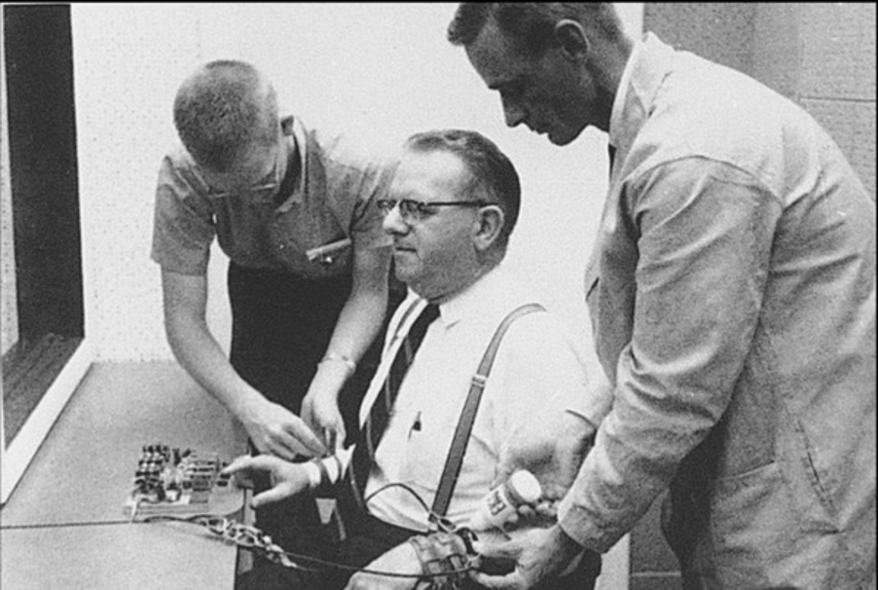
Ethical Guidelines for Participants
Notes:
There are several ways in which researchers ensure that the well-being of their human participants is addressed. Review your authors’ discussion of:
1. Informed consent
2. The right to withdraw at any time for any reason
3. The need to protect confidentiality
4. When deception may be used and how to employ appropriate debriefing procedures
Examine the famous research of Stanley Milgram, which we’ll talk more about in a later chapter, and consider whether his research was ethical. Be careful to remember that the “rules” of research may have been different when this study was conducted versus today’s ethical codes.

Slide 18
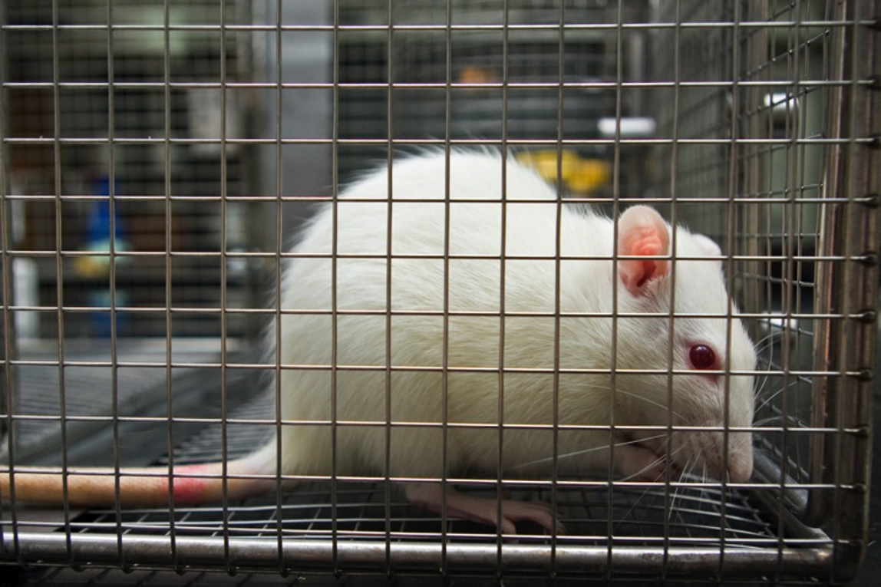
Ethical Guidelines for Animal Research
Notes:
Quite a bit of research done in psychology uses nonhuman animals, and the well-being of those participants must be considered. IRB approval is necessary, the health and safety of the animals must be protected, and pain or discomfort is to be avoided unless it is unavoidable.
The issue of animal research is indeed contentious. How do you feel about using animals in research? Does it change your opinion if you know some animals must die for results to be useful? Would your opinion change if you were talking about a rat versus a monkey?

Slide 19
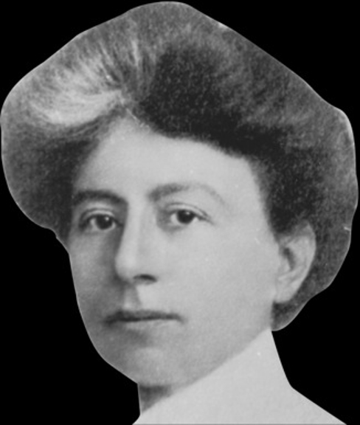
A Notable Beginning
Notes:
The science of psychology is generally believed to have begun in 1879 in the laboratory of Wilhelm Wundt. His model was called structuralism (as named by his student, Edward Titchener) and emphasized identifying the basic elements of experience through introspection.
Titchener’s student, Margaret Washburn, was the first woman in the United States to earn a doctorate in psychology, but she did not share her teacher’s passion for structuralism.

Slide 20
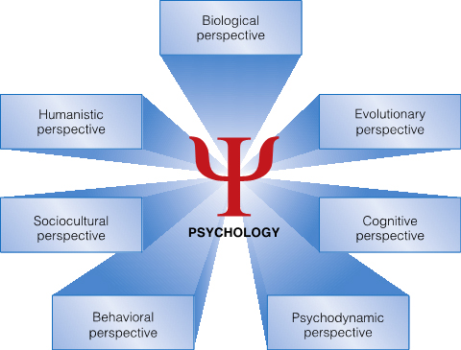
Psychology’s Roots and Modern Perspectives
Psychological Perspectives
Notes:
The variety of perspectives within psychology is wide, with different scientists focusing on different approaches to understanding human behavior. Refer to your text for a thorough review of each of these approaches, including classical ways of thinking that may no longer be a salient part of the field.

Slide 21
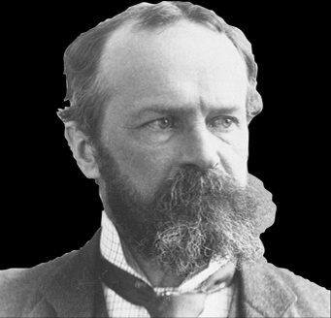
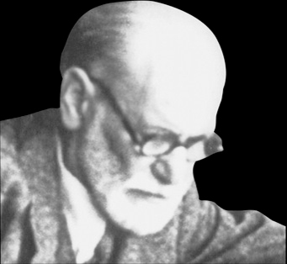
From Structuralism to Functionalism to the Role of the Unconscious
Notes:
American psychologist William James did not agree that the emphasis of psychology should be on searching for how consciousness is comprised but rather for finding its purpose. His model was called functionalism and was heavily influenced by theories of evolution posited by Charles Darwin.
Sigmund Freud, arguably the most widely noted and influential figure in the field, was a neurologist who believed that we’re all affected by forces that exist outside of awareness. He called this the unconscious. His system of psychotherapy, psychoanalysis, was based on this concept.
Some took exception to objectionable parts of Freud’s model and deviated in their emphasis (conscious versus unconscious, distancing themselves from an emphasis on sexuality). These models are called psychodynamic theory.

Slide 22
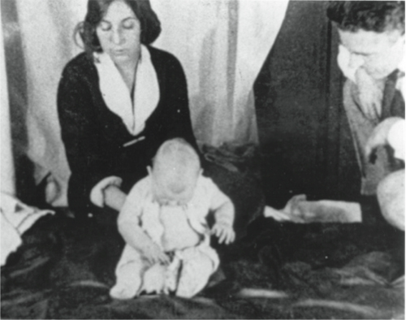

Moving to the Observable
Notes:
John Watson was a leading figure in the behavioral perspective, emphasizing that a science should only focus on observable phenomena that could be measured. He also spoke about the influence of the environment on development. His work influenced B. F. Skinner who developed the theory of operant conditioning.
Consistent with this idea, the sociocultural perspective focuses on how we are affected by social and cultural influences in our surroundings.

Slide 23

Beyond Behaviorism: Humanism, Cognitive Psychology, and the Birth of Positive Psychology
Notes:
A variety of other approaches are important for you to understand, and you’re encouraged to read carefully about them:
The humanistic perspective emphasizes personal growth and free will, noting that each person actively chooses who he or she is and what he or she wants to be and do.
The cognitive perspective focuses on thinking processes, including such topics as intelligence, problem solving, and memory, among others.
Positive psychology, an offshoot of early humanism, emphasizes factors that are involved with happiness, well-being, and positive emotions.

Slide 24
Specialty Areas in Psychology (1 of 3)
TABLE 1.2 Specialty Areas in Psychology
Specialty Area | Topics of Interest
Biopsychology | Researches the biological processes that underlie behavior, including genetic, biochemical, and nervous system functioning.
Clinical psychology | Researches, assesses, and treats children, adolescents, and adults who are experiencing difficulty in functioning or who have a serious mental health disorder such as schizophrenia.
Cognitive psychology | Studies mental processes such as decision making, problem solving, language, and memory.
Community psychology | Seeks to understand and enhance the quality of life for individuals, communities, and society. Focuses on early intervention in and prevention of individual and community problems.
Counseling psychology | Researches, assesses, and treats children, adolescents, and adults who are experiencing adjustment difficulties.
Cross-cultural psychology | Investigates cultural similarities and differences in traits and behaviors and examines the cultural goals, values, and practices that underlie them.
Notes:
If you’ve ever wondered “what do psychologists do?” the answer can be found in this table.

Slide 25
Specialty Areas in Psychology (2 of 3)
Specialty Area | Topics of Interest
Developmental psychology | Researches how we develop physically, cognitively, socially, and emotionally over the life span.
Educational psychology | Researches how people learn and how variables in an educational environment influence learning. May develop materials and strategies to enhance learning.
Environmental psychology | Examines the relationship between environments and human behavior. Focuses on designing, managing, protecting, and/or restoring the environment to enhance behavior. Also studies environmental attitudes, perceptions, and values to promote environmentally appropriate behavior.
Experimental psychology | Conducts research on sensation, perception, learning, motivation, and emotion.
Forensic psychology | Works with mental health issues within the context of the legal system. May study a certain type of criminal behavior such as rape or murder, or may be asked to determine a person's competence to stand trial.
Notes:
If you’ve ever wondered “what do psychologists do?” the answer can be found in this table.

Slide 26
Specialty Areas in Psychology (3 of 3)
Specialty Area | Topics of Interest
Health psychology | Researches ways to promote health and prevent illness. May be concerned with issues such as diet and nutrition, exercise, and lifestyle choices that influence health.
Human factors psychology | Researches human capabilities as they apply to the design, operation, and maintenance of machines, systems, and environments to achieve optimal performance (for example, designing the most effective configuration of control knobs in airplane cockpits for pilots).
Industrial/organizational (I/O) psychology | Examines the relationship between people and their work environments. May study issues such as increasing job satisfaction or decreasing employee absenteeism, or focus on understanding the dynamics of workplace behavior, such as leadership styles or gender differences in management styles.
Personality psychology | Researches how people differ in their individual traits, how people develop personality, whether personality traits can be changed, and how these qualities can be measured.
Positive psychology | Seeks to discover and promote those factors that contribute to happiness, positive emotions, and well-being.
School psychology | Assesses students' psychoeducational abilities (academic achievement, intelligence, cognitive processing) and shares test results with teachers and parents to help them make decisions regarding the best educational placement for students.
Social psychology | Researches how our beliefs, feelings, and behaviors are influenced by others, whether in the classroom, on an elevator, on the beach, on a jury, or at a football game.
Sports psychology | Investigates the mental and emotional aspects of physical performance.
Notes:
If you think about a psychologist as a clinician who helps people with their troubles, you are only thinking of a small percentage of the possible careers in the field.

Slide 27
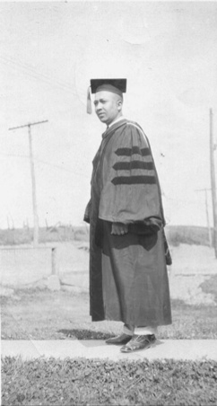
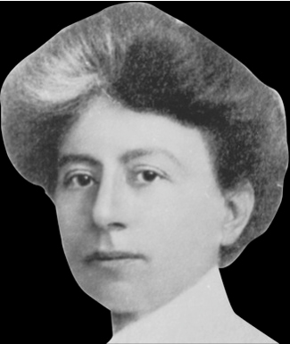
Gender, Ethnicity, and the Field of Psychology
Notes:
In addition to Washburn, other people broke through race and gender barriers in psychology. Mary Calkins, Christine Ladd-Franklin, Karen Horney, Gilbert Haven Jones, Francis Sumner, and Kenneth and Mamie Clark were just some of those many individuals who had to fight through cultural and institutional barriers, and all of them made enormous contributions to the field.
Review the text’s discussion of how women and minority individuals play an enormous role in today’s psychology and are leading the future thinking in the field!

Slide 28
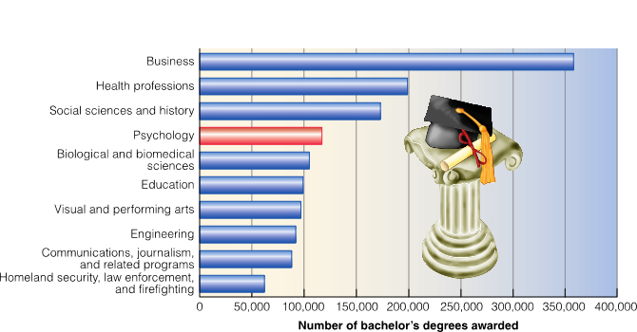
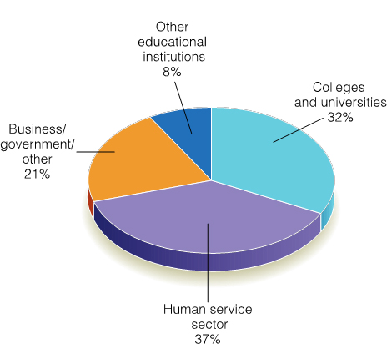
Training to Be a Psychologist
Undergraduate Degrees in Psychology
Work Settings of Psychologists
Notes:
If you wonder what it takes to get a degree in psychology, what graduate opportunities exist, and how the training will position you for a career in the field, review the Psychology Applies to Your World feature in the textbook.
Remember that an undergraduate degree in psychology can open many doors outside of the field. As an example, can you imagine psychology leading you into a legal or medical profession?

